Slide 1
XXXXX
OrcaFlex Python Interface Development
10 February 2018

Slide 2
Introduction
TBA

Slide 3
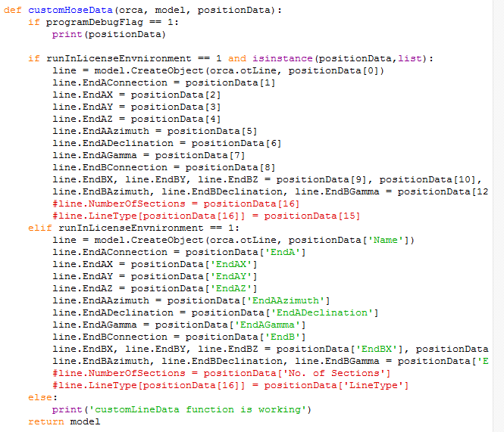
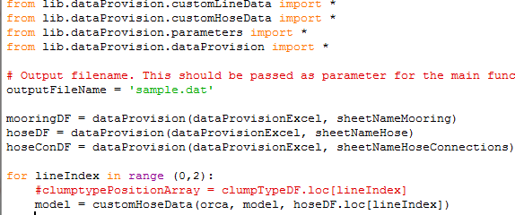
Folder Structure
Excel Sheet
Function File
Main file
1/ Excel data is readied through main file.
2/ Functions takes these values and assigned into the OrcaFlex model
3/ After it go back to main file and executes remaining code

Slide 4
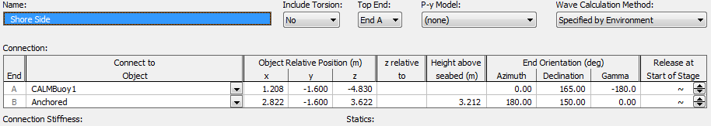
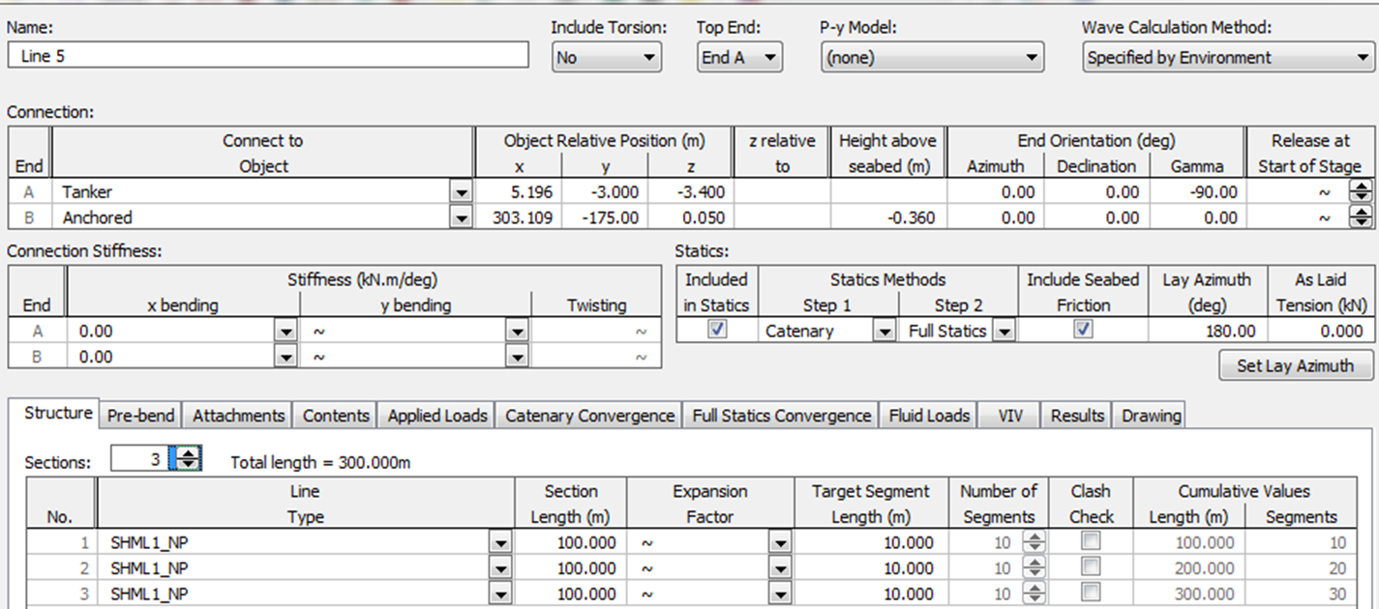
Continue..
OrcaFlex model
We are defining only highlighted section data in OrcaFlex. We need to implement this code nd defines sections lengths also .

Slide 5
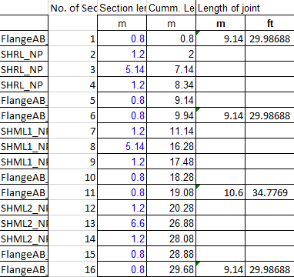
Further implementation
Excel Sheet 1
Excel Sheet 2
Main file
Function File
1/ Now I’m trying to read these 2 excel data into one function file with two different indexes.
2/ Define its values into OrcaFlex model at a time.

Slide 6

Continue..
1/ We are trying to define line coordinates and its structural properties at a time. For this we need 2 indexex and add few more lines to the line data function file code.
2/ Function code follows in below location.

Slide 7
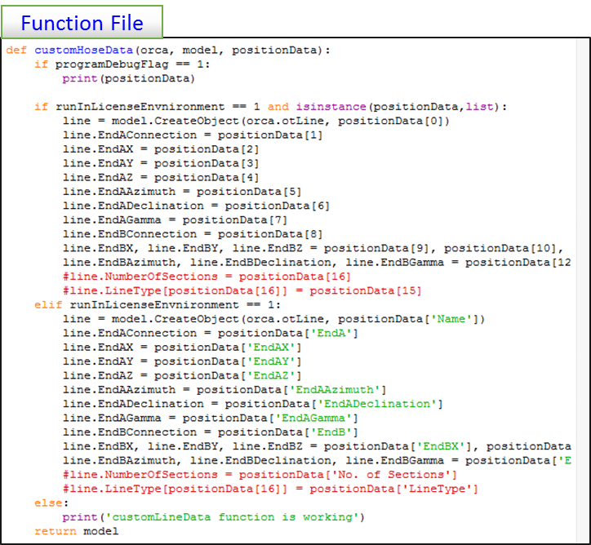
Function code
These lines are run with one index data.
1/ These 2 lines are run with another index data. For these we need to excute these lines to completions of first code. But these two indexes are assigned into the same line in OrcaFlex.
2/ I don’t know how to write code for this type of two different index.

Slide 8
LineTypeOuterDiameter Creation
# It creates Line Type Outer Diameter profile
lineoutdia = model.CreateObject(orca.otLineTypeOuterDiameter)
lineoutdia.NumberOfRows = 2
lineoutdia.IndependentValue[0] = 1
lineoutdia.DependentValue[0] = 2
We are getting errors in this code. I’m highlighted the error line.
‘LineTypeOuterDiameter’ Name is not considered in OrcaFlex.

Slide 9
OrcaFlex Runs
Test Run
(Folder Name : Test)
Full Run
(Folder Name : Full)
10 Sec
Regular Run

Slide 10
THANK YOU
For the opportunity to serve

